Slide 1



Noida Institute of Engineering and Technology, Greater Noida
Network Layer
Unit: 3
Computer Networks (ACSE0602)
Nisha
(Assistant Professor)
ECE
Department
B Tech 6th Sem

Slide 2



Noida Institute of Engineering and Technology, Greater Noida
Nisha received her B.Tech degree in Electronics and Communication engineering from institute of engineering and technology, Agra . M.Tech degree in VLSI design from A.K.G. Engineering college, Ghaziabad, and Uttar Pradesh, India and major areas of research work include low power circuit design. Published papers are Analysis of low power 32-bit Brent kung adder with ground bouncing noise optimization & A review of ground-bouncing-noise minimization techniques in MTCMOS circuits have 5 years of teaching experience.

Slide 3
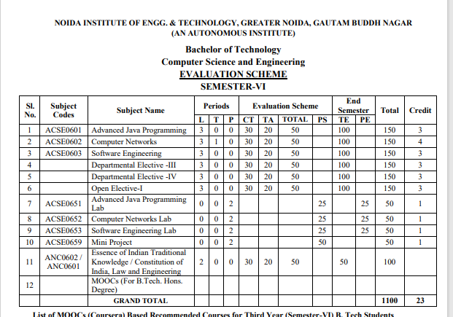
Curriculum

Slide 4
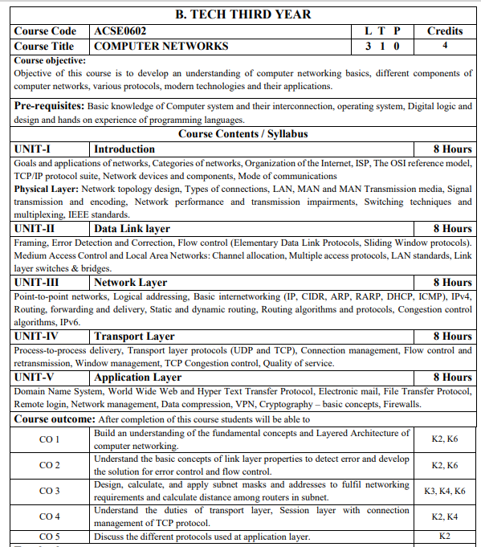
Syllabus

Slide 5
Books
Text books:
Behrouz Forouzan, “Data Communication and Networking” Fourth Edition-2006, Tata McGraw Hill
Andrew Tanenbaum “Computer Networks”, Fifth Edition-2011, Prentice Hall.
William Stallings, “Data and Computer Communication”, Eighth Edition-2008, Pearson.
Reference Books:
Kurose and Ross, “Computer Networking- A Top-Down Approach”, Eighth Edition-2021, Pearson.
Peterson and Davie, “Computer Networks: A Systems Approach”, Fourth Edition-1996, Morgan Kaufmann

Slide 6
Course Objective
The objective of this course is to understand introduction of computer networks with suitable transmission media and different networking devices. Network protocols which are essential for the computer network are need to explain such as data link layer protocols and routing protocols.
A detail explanation of IP addressing , TCP/IP protocols and application layer protocols are covered in this course.

Slide 7
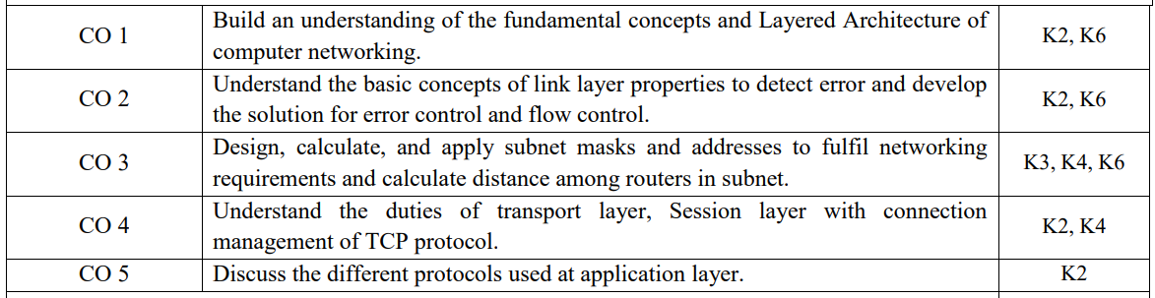
Course Outcome

Slide 8
PO’s
1.Engineering knowledge
2. Problem analysis
3. Design/development of solutions
4. Conduct investigations of complex problems
5. Modern tool usage
6. The engineer and society
7. Environment and sustainability
8. Ethics
9. Individual and team work
10. Communication
11. Project management and finance
12. Life-long learning

Slide 9
CO-PO Mapping
Computer Networks(ACSE- 603) |  |  |  |  |  |  |  |  | Year of Study: 2023-24
CO | PO1 | PO2 | PO3 | PO4 | PO5 | PO6 | PO7 | PO8 | PO9 | PO10 | PO11 | PO12
ACSE0602.1 | 3 | 2 | 2 |  | 2 |  |  |  | 2 |  | 2 | 3
ACSE0602.2 | 3 | 3 | 2 |  |  |  |  |  |  |  |  | 3
ACSE0602.3 | 3 | 3 | 3 | 3 | 2 |  |  |  | 2 |  | 2 | 3
ACSE0602.4 | 3 | 2 | 2 |  | 2 |  |  |  |  |  |  | 3
ACSE0602.5 | 3 | 3 | 2 |  | 2 | 3 |  | 2 |  |  |  | 3
Average | 3 | 2 | 2 |  | 2 | 2 |  | 2 | 2 |  | 2 | 3

Slide 10
PSO’s
On successful completion of graduation degree, The computer Science & Engineering graduates will be able to:
PSO1: identify, analyze real world problems and design their ethical solutions using artificial intelligence, robotics, virtual/augmented reality, data analytics, block chain technology, and cloud computing.
PSO2: design and develop the hardware sensor devices and related interfacing software systems for solving complex engineering problems.
PSO 3: understand inter-disciplinary computing techniques and to apply them in the design of advanced computing.
PSO 4: conduct investigation of complex problem with the help of technical, managerial, leadership qualities, and modern engineering tools provided by industry sponsored laboratories.

Slide 11
PSO’s
CO | PSO1 | PSO2 | PSO3 | PSO4
ACSE0602.1 | 2 | 2 | 2 | 2
ACSE0602.2 | 2 | 2 | 2 | 2
ACSE0602.3 | 2 | 2 | 2 | 3
ACSE0602.4 | 2 | 2 | 2 | 2
ACSE0602.5 | 2 | 2 | 2 | 2
Avg | 2 | 2 | 2 | 2

Slide 12
Program Educational Objectives
PEO 1: To have an excellent scientific and engineering breadth so as to comprehend, analyze, design and provide sustainable solutions for real-life problems using state-of-the-art technologies.
PEO 2: To have a successful career in industries, to pursue higher studies or to support entrepreneurial endeavors and to face the global challenges.
PEO 3:To have an effective communication skills, professional attitude, ethical values and a desire to learn specific knowledge in emerging trends, technologies for research, innovation and product development and contribution to society.
PEO 4: To have life-long learning for up-skilling and re-skilling for successful professional career as engineer, scientist, entrepreneur and bureaucrat for betterment of society.

Slide 13
Result Analysis
COMPUTER NETWORKS (ACSE0602)
Department wise Result of VI sem. | 100
Subject wise result | 99
Faculty wise result | 99

Slide 14
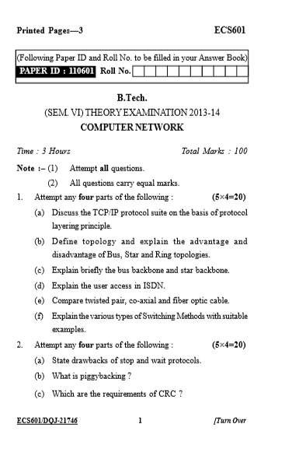
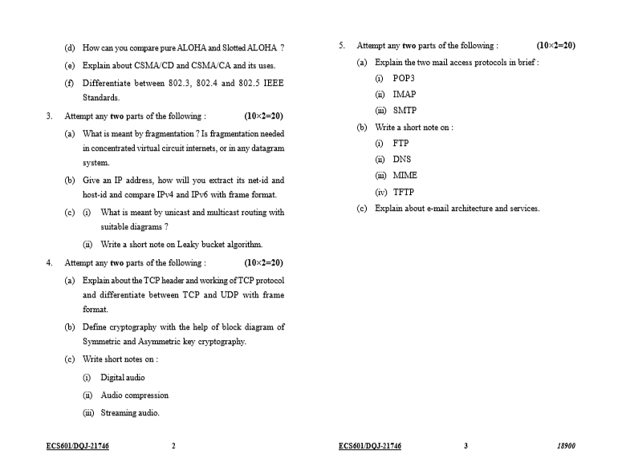
End semester Question paper templates

Slide 15
Prerequisite and Recap
Networking components
Concept of physical addressing
Concept of OSI and TCP/IP model
In previous unit
Data link layer duties
Multi access protocol
Error control

Slide 16
Content
Unit 3
Point-to-point networks
Logical addressing (IPv4)
Basic internetworking (IP, CIDR ARP, RARP, DHCP, ICMP)
Routing, forwarding and delivery
Static and dynamic routing
Routing algorithms and protocols
Congestion control algorithms
IPv6.

Slide 17
Network Layer Functions
Objective: Study about basic concept of Network layer and its function
Getting packets from the source all the way to the destination
May require many hops through intermediate routers.
It must know about the topology of the communication subnet ( the set of all routers) and choose appropriate paths through it.
It must take care to choose routers to avoid overloading some of the lines and routers while leaving others idle.
When source and destination are in different networks, it has to deal with the differences.

Slide 18
Network Layer Functions
Encapsulation - The network layer receives a protocol data unit (PDU) from the transport layer. In a process called encapsulation, the network layer adds IP header information, such as the IP address of the source (sending) and destination (receiving) hosts. After header information is added to the PDU, the PDU is called a packet.
Routing - The network layer provides services to direct packets to a destination host on another network. To travel to other networks, the packet must be processed by a router.
De-encapsulation - When the packet arrives at the network layer of the destination host, the host checks the IP header of the packet. If the destination IP address within the header matches its own IP address, the IP header is removed from the packet. This process of removing headers from lower layers is known as de-encapsulation.

Slide 19
Network Layer

Slide 20
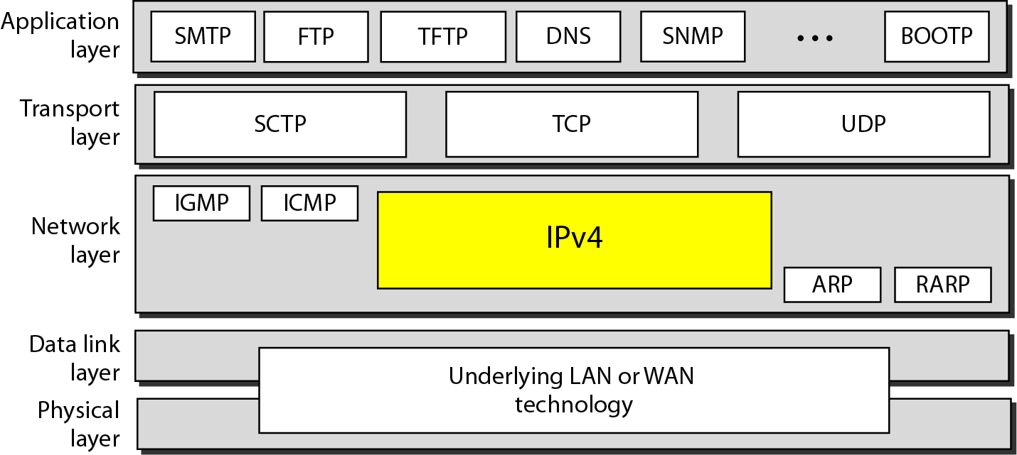
Network Layer Protocols

Slide 21
Network Layer Protocols
There are several network layer protocols in existence; however, only the following two are commonly implemented:
Internet Protocol version 4 (IPv4)
Internet Protocol version 6 (IPv6)
Other legacy network layer protocols that are not widely used include:
Novell Internetwork Packet Exchange (IPX)
AppleTalkConnectionless Network Service (CLNS/DECNet)

Slide 22
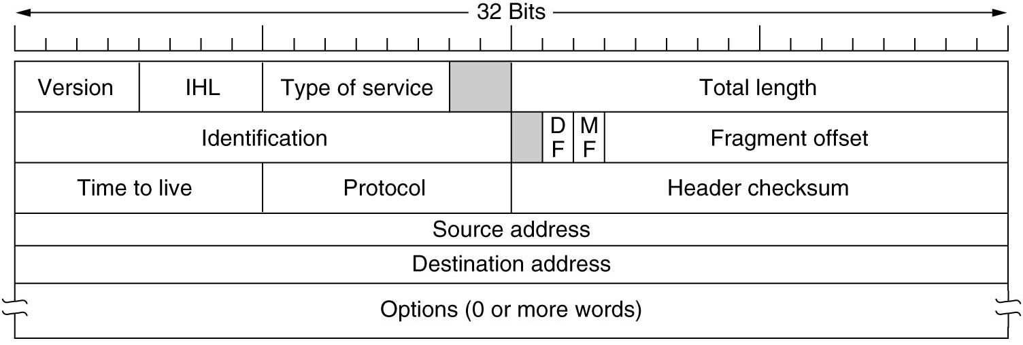
IPv4 Protocol

Slide 23
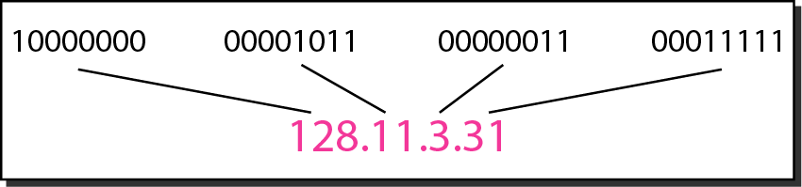
IPv4 Protocol
Objective: Study about basic concept of IP addressing and its type
An IPv4 address is a 32-bit address that uniquely and universally defines the connection of a device (for example, a computer or a router) to the Internet.
The address space of IPv4 is 2³² or 4,294,967,296.
Dotted-decimal notation and binary notation for an IPv4 address

Slide 24
IPv4 Example
Change the following IPv4 addresses from binary notation to dotted-decimal notation.
Solution
We replace each group of 8 bits with its equivalent decimal number (see Appendix B) and add dots for separation.

Slide 25
IPv4 example
Change the following IPv4 addresses from dotted-decimal notation to binary notation.
Solution
We replace each decimal number with its binary equivalent

Slide 26
IPv4 example
Find the error, if any, in the following IPv4 addresses.
Solution
a. There must be no leading zero (045).
b. There can be no more than four numbers.
c. Each number needs to be less than or equal to 255.
d. A mixture of binary notation and dotted-decimal notation is not allowed.

Slide 27
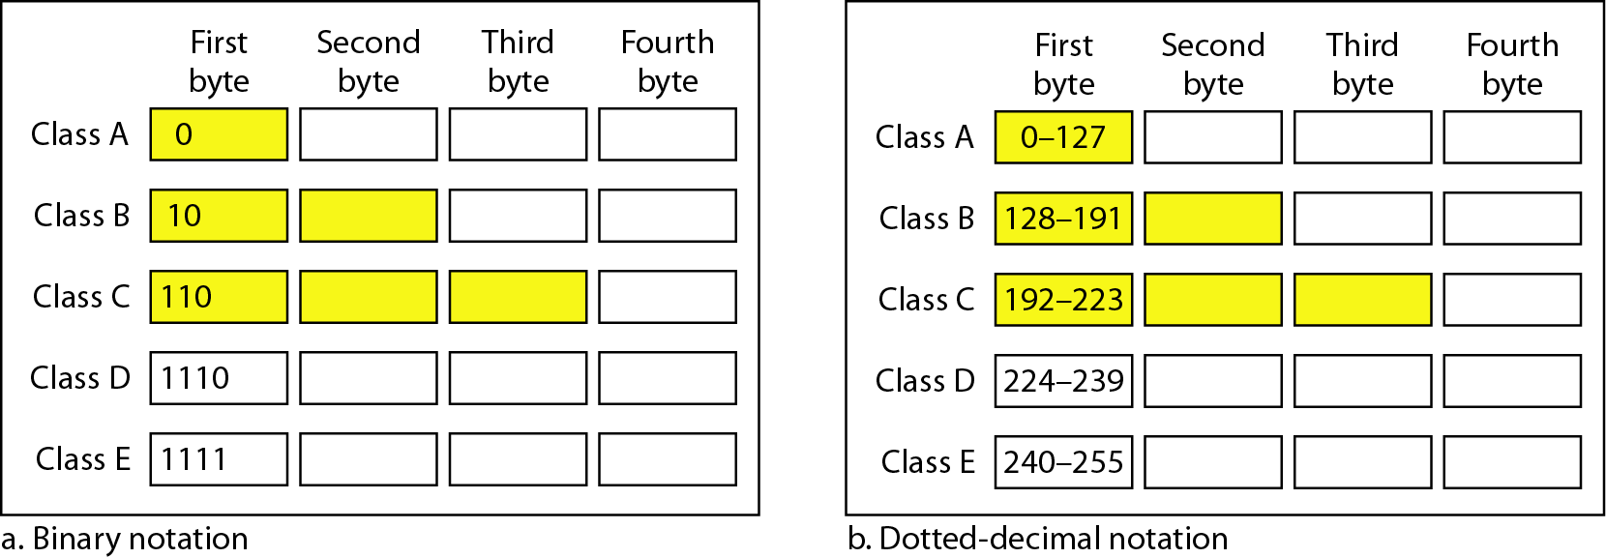
IPv4 address classification
Finding the classes in binary and dotted-decimal notation
In classful addressing, the address space is divided into five classes:
A, B, C, D, and E.

Slide 28
IPv4 address classification
Find the class of each address.
a. 00000001 00001011 00001011 11101111
b. 11000001 10000011 00011011 11111111
c. 14.23.120.8
d. 252.5.15.111
Solution
a. The first bit is 0. This is a class A address.
b. The first 2 bits are 1; the third bit is 0. This is a class C address.
c. The first byte is 14; the class is A.
d. The first byte is 252; the class is E.

Slide 29
IPv4 address classification
Number of blocks and block size in classful IPv4 addressing
In classful addressing, a large part of the available addresses were wasted.
Default masks for classful addressing

Slide 30
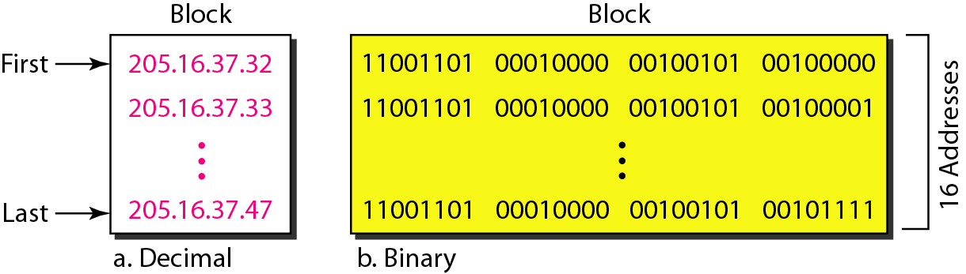
IPv4 address classification
A block of 16 addresses granted to a small organization
Classful addressing, which is almost obsolete, is replaced with classless addressing.

Slide 31
IPv4 address : classless addressing
In IPv4 addressing, a block of addresses can be defined as
x.y.z.t /n
in which x.y.z.t defines one of the addresses and the /n defines the mask.
The first address in the block can be found by setting the rightmost 32 − n bits to 0s.
The last address in the block can be found by setting the rightmost 32 − n bits to 1s.
The number of addresses in the block can be found by using the formula 2^{32−n}.

Slide 32
Daily Quiz
What is the primary function of the Network Layer in the OSI model?
A) Error detection
B) Data link
C) Routing
D) Physical transmission
Which protocol operates at the Network Layer for addressing and routing in the Internet?
A) TCP
B) IP
C) UDP
D) ICMP
Which of the following devices operates at the Network Layer?
A) Hub
B) Switch
C) Router
D) Repeater
What is the size of the IPv4 address?
A) 32 bits
B) 64 bits
C) 128 bits
D) 16 bits

Slide 33
IPv4 address : classless addressing
Example 19.6
Classless addressing

Slide 34
IPv4 address : classless addressing
Example 19.6
A block of addresses is granted to a small organization. We know that one of the addresses is 205.16.37.39/28. What is the first address in the block?
Solution
The binary representation of the given address is
11001101 00010000 00100101 00100111
If we set 32−28 rightmost bits to 0, we get
11001101 00010000 00100101 0010000
or 205.16.37.32.

Slide 35
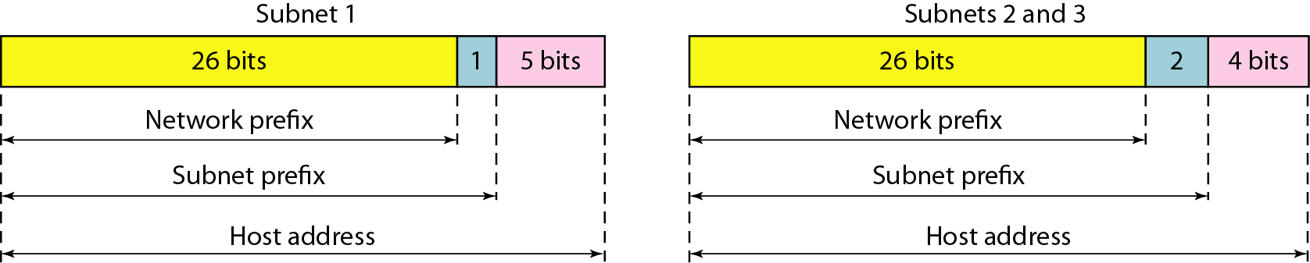
IPv4 address : classless addressing
Three-level hierarchy in an IPv4 address

Slide 36
IPv4 address : classless addressing
An ISP is granted a block of addresses starting with 190.100.0.0/16 (65,536 addresses). The ISP needs to distribute these addresses to three groups of customers as follows:
The first group has 64 customers; each needs 256 addresses.
b. The second group has 128 customers; each needs 128 addresses.
c. The third group has 128 customers; each needs 64 addresses.
Design the sub blocks and find out how many addresses are still available after these allocations.

Slide 37
IPv4 address : classless addressing
Group 1
For this group, each customer needs 256 addresses. This means that 8 (log2 256) bits are needed to define each host. The prefix length is then 32 − 8 = 24. The addresses are

Slide 38
IPv4 address : classless addressing
Example 19.10 (continued)
Group 2
For this group, each customer needs 128 addresses. This means that 7 (log2 128) bits are needed to define each host. The prefix length is then 32 − 7 = 25. The addresses are

Slide 39
IPv4 address : classless addressing
Example 19.10 (continued)
Group 3
For this group, each customer needs 64 addresses. This means that 6 (log₂64) bits are needed to each host. The prefix length is then 32 − 6 = 26. The addresses are
Number of granted addresses to the ISP: 65,536
Number of allocated addresses by the ISP: 40,960
Number of available addresses: 24,576

Slide 40
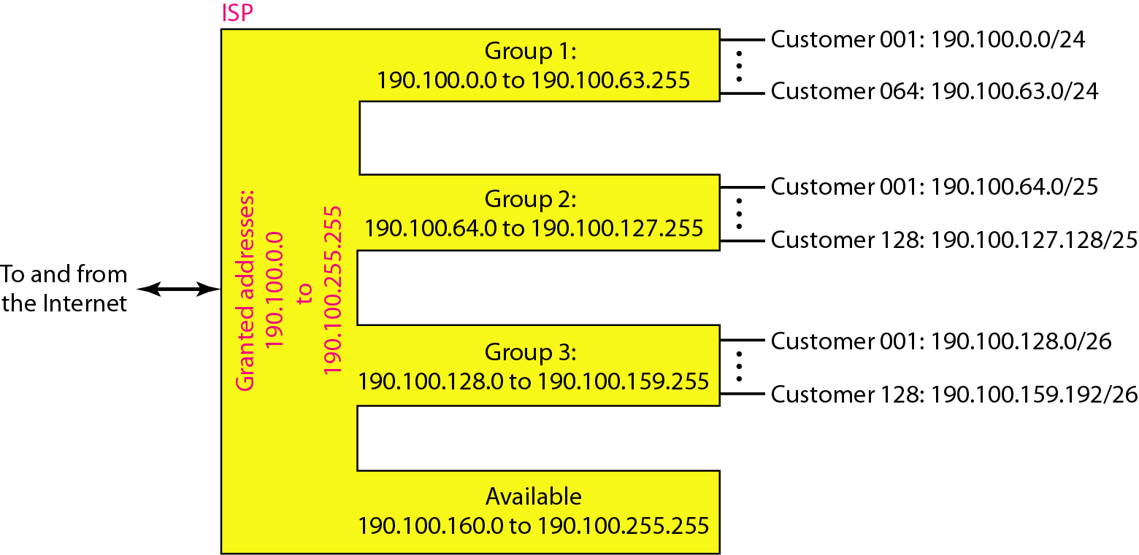
IPv4 address : classless addressing
An example of address allocation and distribution by an ISP

Slide 41
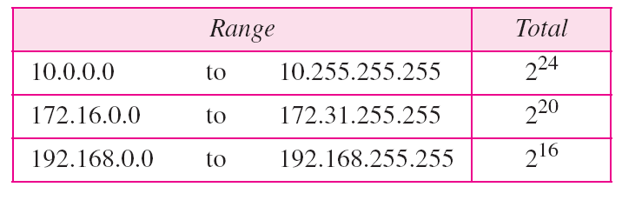
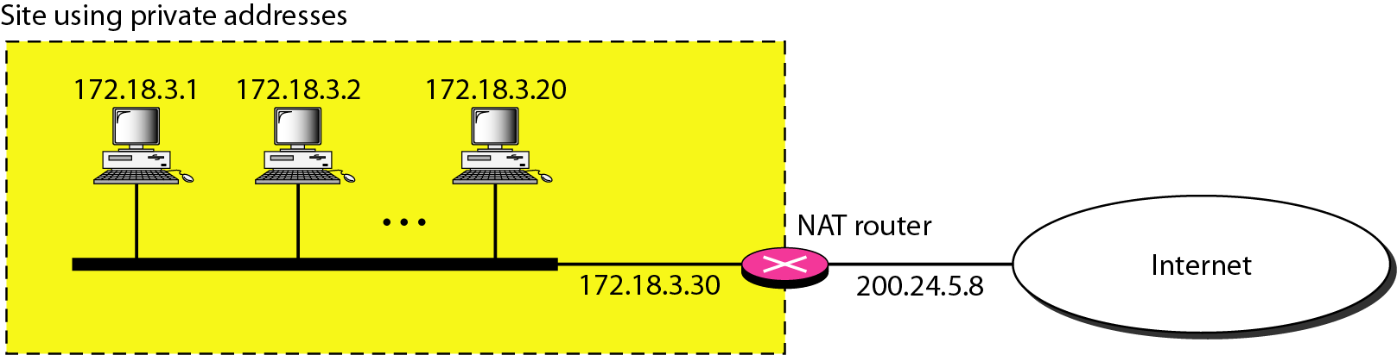
IPv4 address : classless addressing
Addresses for private networks

Slide 42
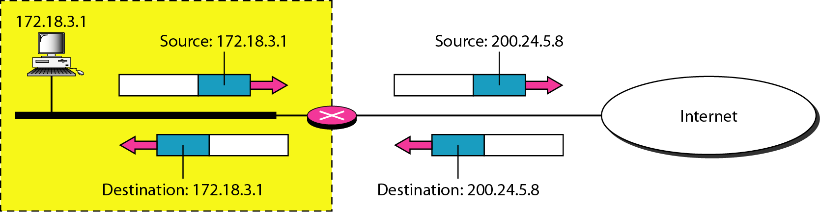
IPv4 address
Addresses in a NAT

Slide 43
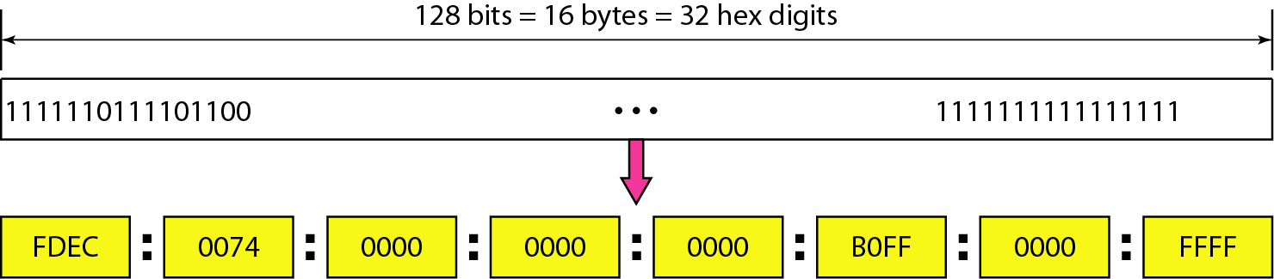
IPv6 address
Objective: Study about basic concept of IPv6 and its function
Despite all short-term solutions, address depletion is still a long-term problem for the Internet. This and other problems in the IP protocol itself have been the motivation for IPv6
An IPv6 address is 128 bits long.

Slide 44
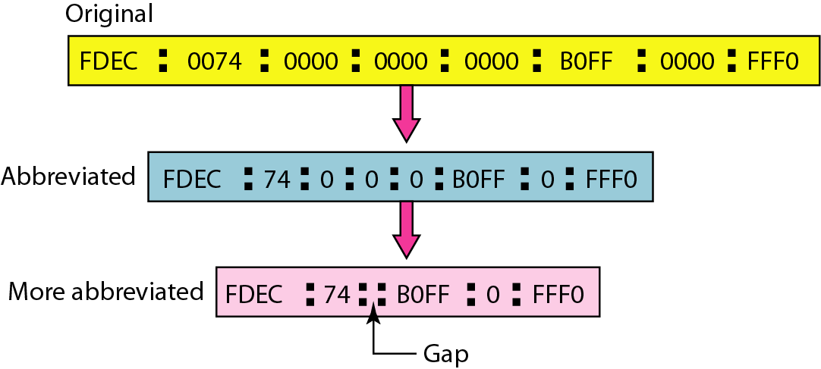
IPv6 address
IPv6 address in binary and hexadecimal colon notation

Slide 45
IPv6 address
Expand the address 0:15::1:12:1213 to its original.
Solution
We first need to align the left side of the double colon to the left of the original pattern and the right side of the double colon to the right of the original pattern to find how many 0s we need to replace the double colon.
This means that the original address is.

Slide 46
IPv6 address
IPv6 address in binary and hexadecimal colon notation

Slide 47
Routing
Objective: Study about basic concept of Routing and its type
An internet is a combination of networks connected by routers. When a datagram goes from a source to a destination, it will probably pass through many routers until it reaches the router attached to the destination network.

Slide 48
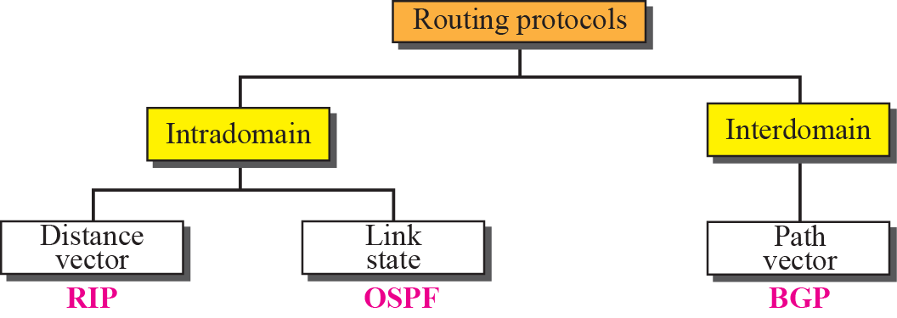
Routing

Slide 49
Routing
DISTANCE VECTOR ROUTING: Updating of Routing table
If the next-node entry is different
The receiving node chooses the row with the smaller cost
If there is a tie, the old one is kept
If the next-node entry is the same
i.e. the sender of the new row is the provider of the old entry
The receiving node chooses the new row, even though the new value is infinity.

Slide 50
Routing
Periodic Update
A node sends its routing table, normally 30 seconds, in a periodic update
Triggered Update
A node sends its routing table to its neighbors any time when there is a change in its routing table
1. After updating its routing table, or
2. Detects some failure in the neighboring links

Slide 51
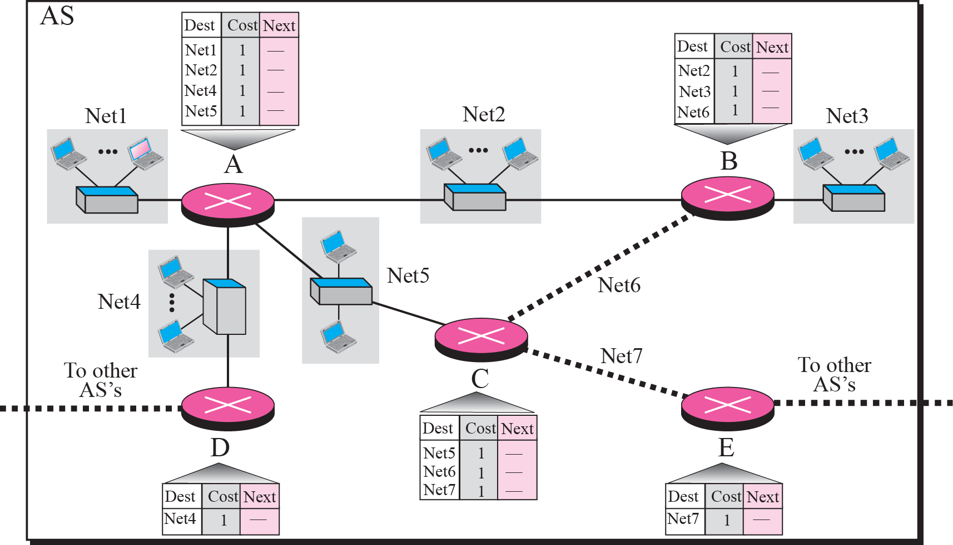
Routing
Figure shows the initial routing table for an AS. Note that the figure does not mean that all routing tables have been created at the same time; each router creates its own routing table when it is booted.

Slide 52
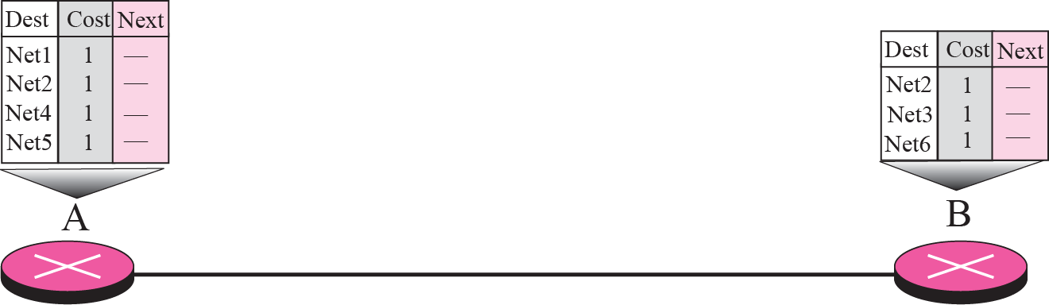
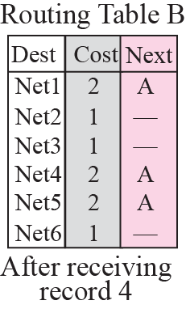
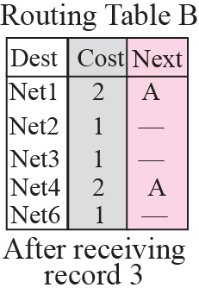
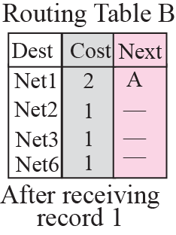
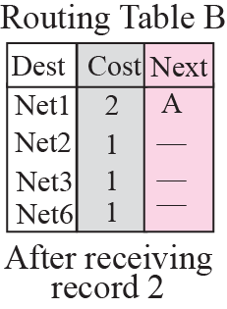
Routing
Now assume router A sends four records to its neighbors, routers B, D, and C. shows the changes in B’s routing table when it receives these records.

Slide 53
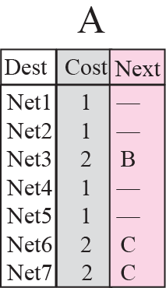
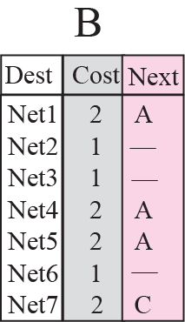
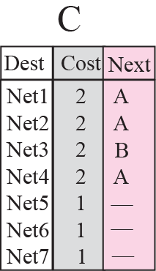
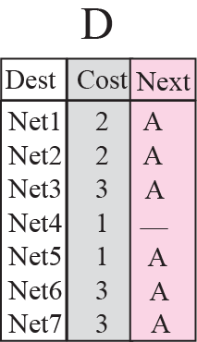
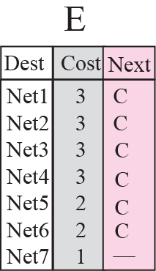
Routing

Slide 54
Routing
The Routing Information Protocol (RIP) is an intra-domain (interior) routing protocol used inside an autonomous system. It is a very simple protocol based on distance vector routing. RIP implements distance vector routing directly with some considerations.

Slide 55
Routing: Link state Routing
Link state routing has a different philosophy from that of distance vector routing. In link state routing, if each node in the domain has the entire topology of the domain—the list of nodes and links, how they are connected including the type, cost (metric), and the condition of the links (up or down)—the node can use the Dijkstra algorithm to build a routing table.

Slide 56
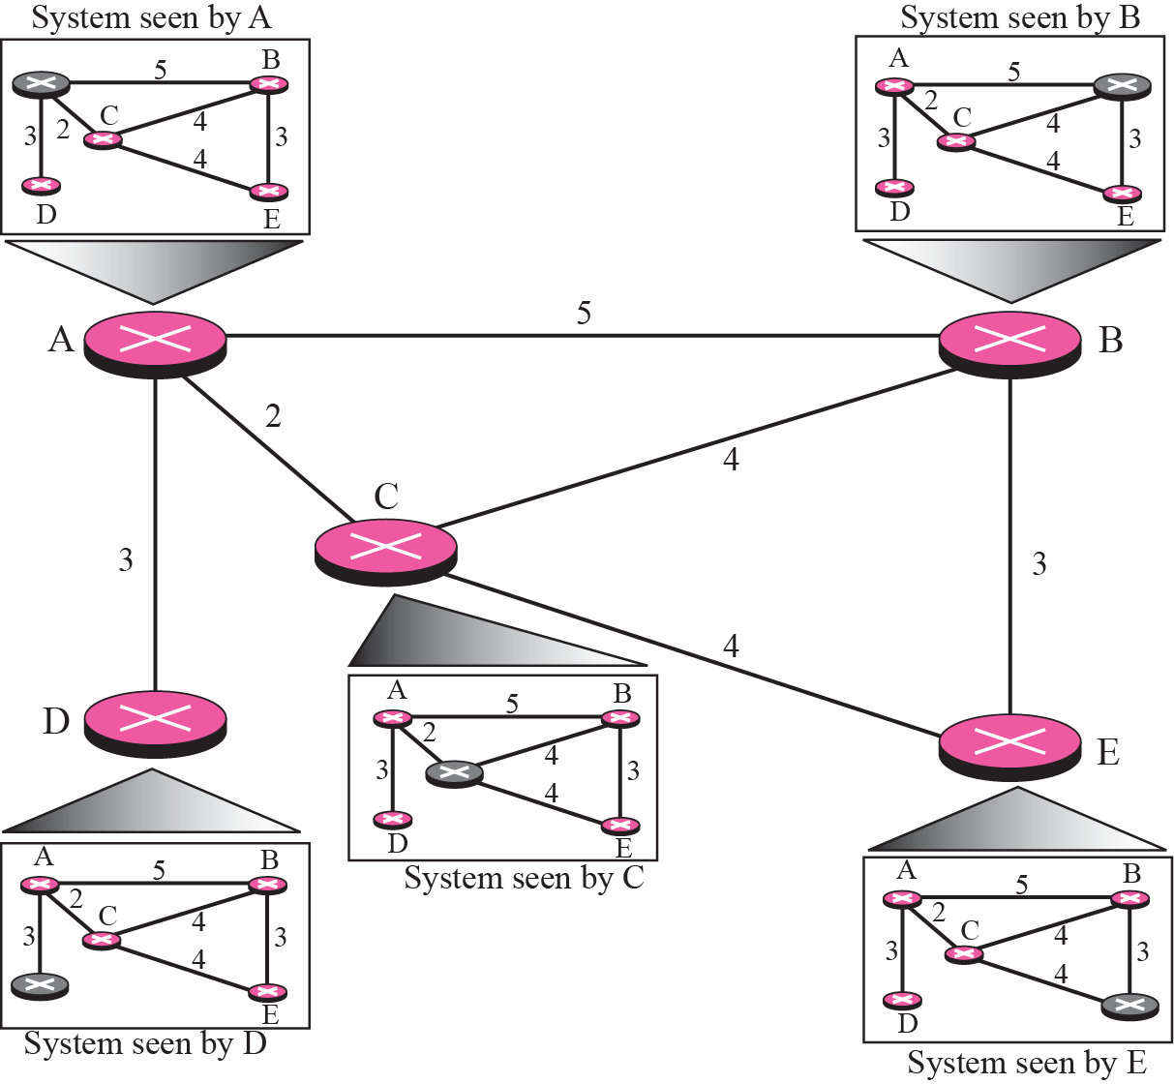
Routing

Slide 57
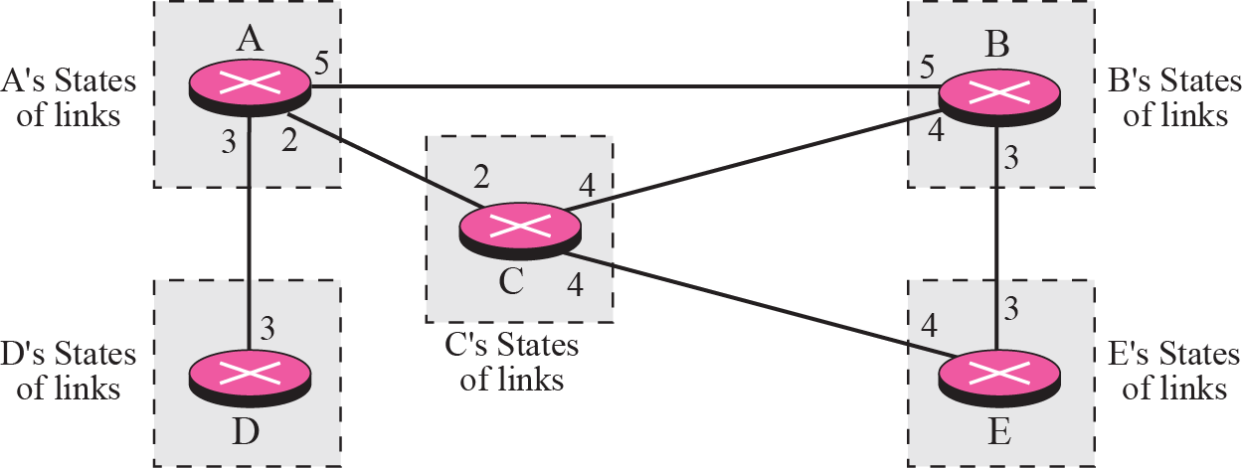
Routing

Slide 58
Routing
Building Routing Tables
Creation of the states of the links by each node, called the link state packets (LSP)
Dissemination of LSPs to every other routers, called flooding (efficiently)
Formation of a shortest path tree for each node
Calculation of a routing table based on the shortest path tree

Slide 59
Routing
Creation of LSP
LSP data: the node ID, the list of links, a sequence number, and age.
LSP Generation
When there is a change in the topology of the domain
On a periodic basis
There is no actual need for this type of LSP, normally 60 minutes or 2 hours

Slide 60
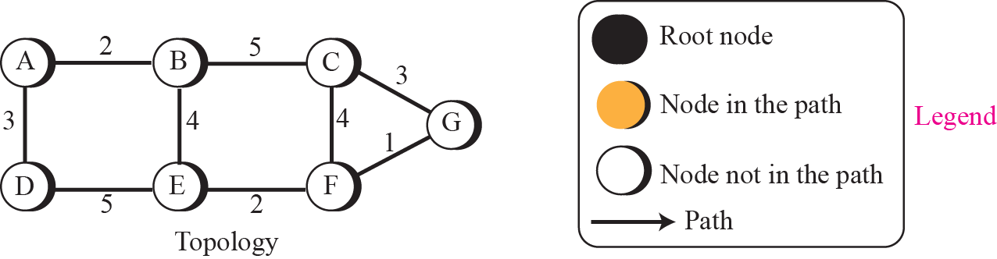
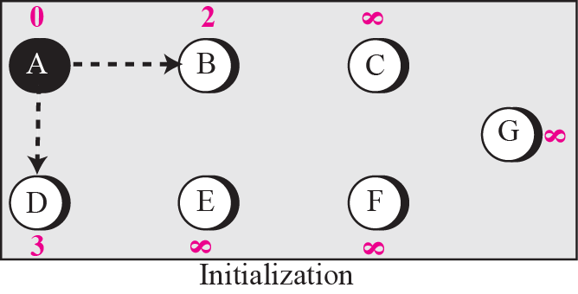
Routing
Forming shortest path three for router A in a graph

Slide 61
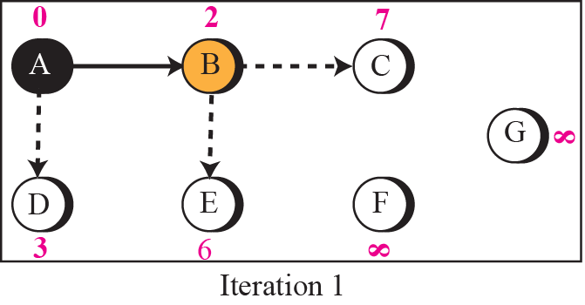
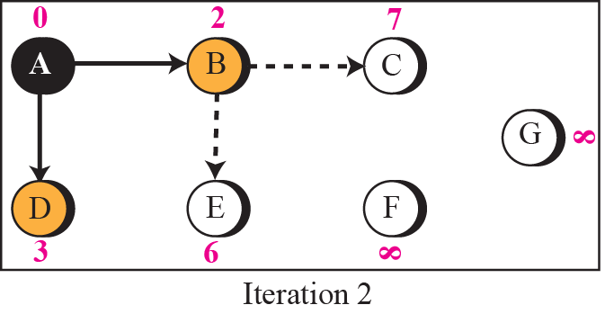
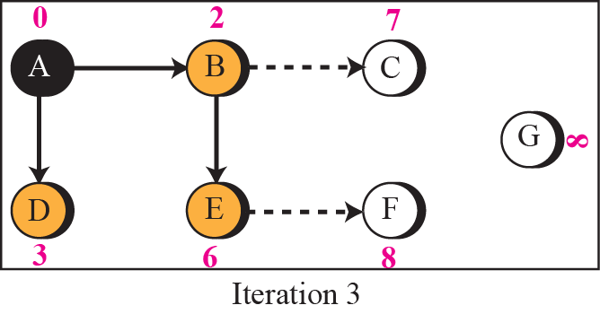
Routing

Slide 62
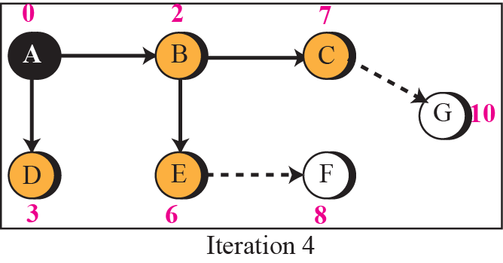
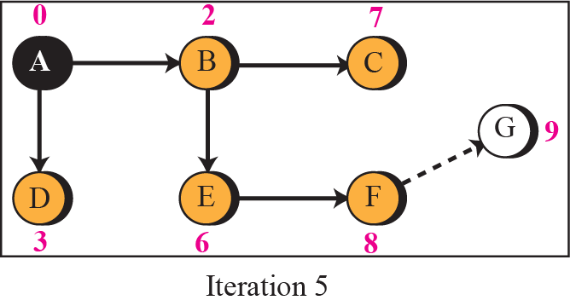
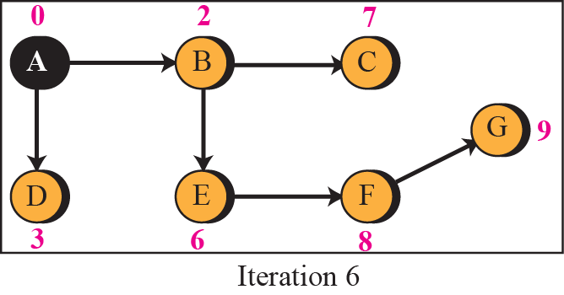
Routing

Slide 63
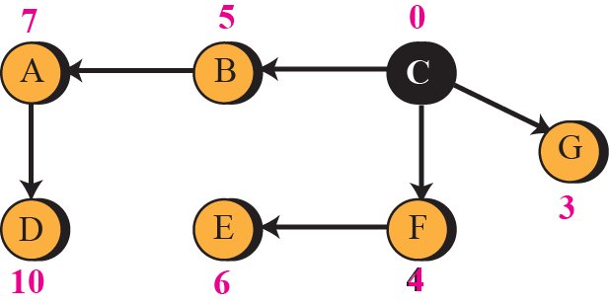
Routing
To show that the shortest path tree for each node is different, we found the shortest path tree as seen by node C.

Slide 64
Routing

Slide 65
Daily Quiz
Which field in the IPv4 header is used for error checking and correction?
A) Source IP Address
B) Destination IP Address
C) Checksum
D) TTL (Time to Live)
Which routing algorithm considers the entire network topology to make routing decisions?
A) Distance Vector
B) Link State
C) RIP
D) OSPF
What is the purpose of the TTL (Time to Live) field in the IPv4 header?
A) Sets the maximum transmission speed
B) Limits the time a packet can live in the network
C) Specifies the time for a packet to reach its destination
D) Controls the packet priority
In IPv6, what is the size of the address space compared to IPv4?
A) Smaller
B) Same
C) Larger
D) Equal

Slide 66
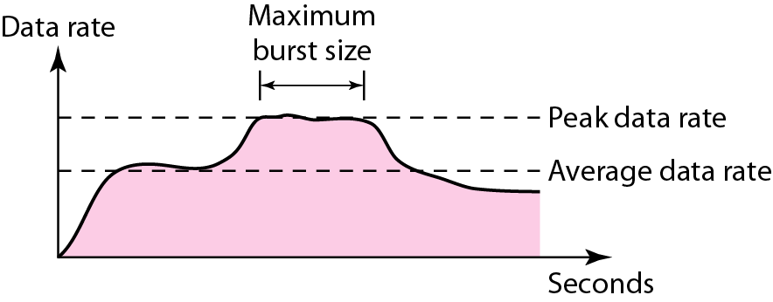
Congestion Control
Objective: Study about basic concept of congestion control and its type
Data traffic
The main focus of congestion control and quality of service is data traffic. In congestion control we try to avoid traffic congestion. In quality of service, we try to create an appropriate environment for the traffic. So, before talking about congestion control and quality of service, we discuss the data traffic itself.
Traffic descriptors

Slide 67
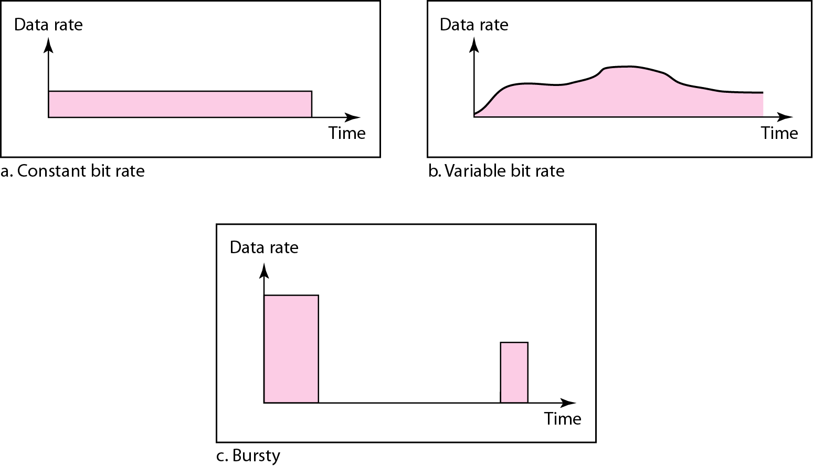
Congestion Control
Three traffic profiles

Slide 68
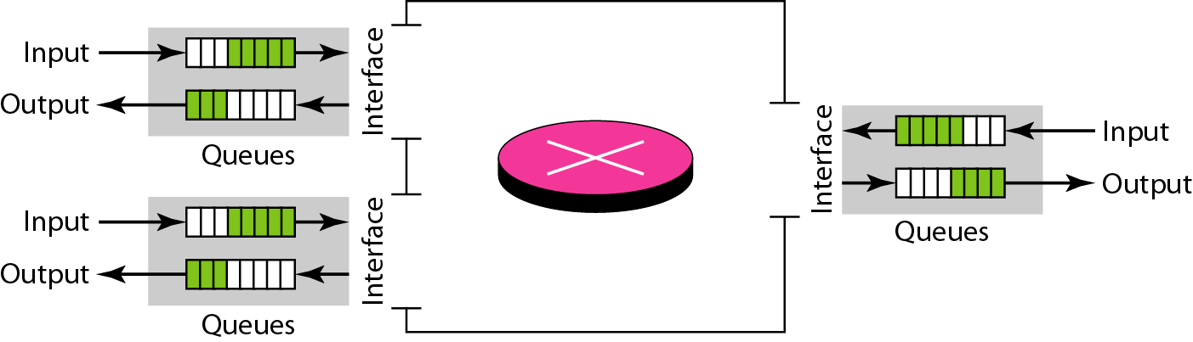
Congestion Control
Congestion in a network may occur if the load on the network—the number of packets sent to the network—is greater than the capacity of the network—the number of packets a network can handle. Congestion control refers to the mechanisms and techniques to control the congestion and keep the load below the capacity.
Queues in a router

Slide 69
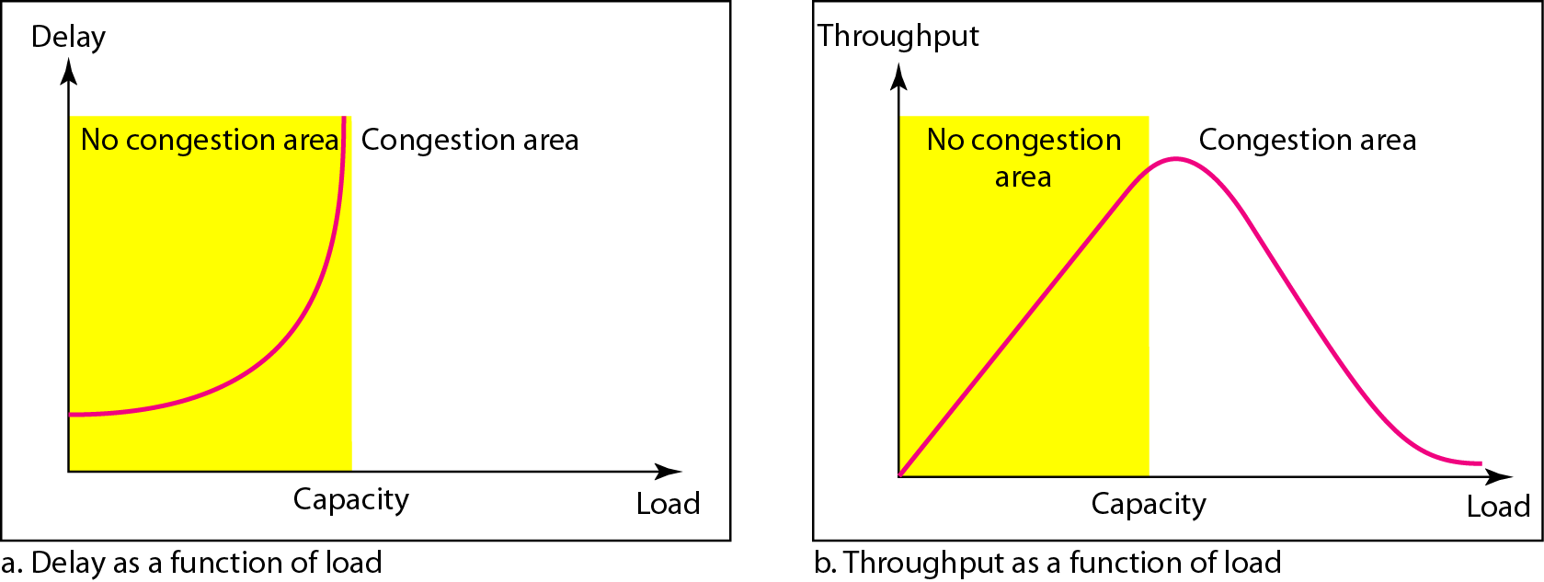
Congestion Control
Packet delay and throughput as functions of load

Slide 70
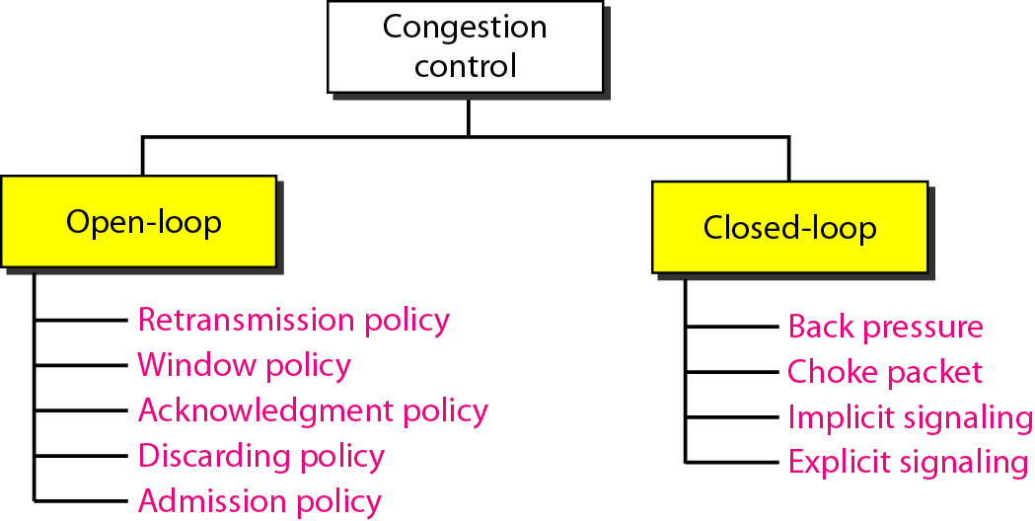
Congestion Control
Congestion control categories

Slide 71
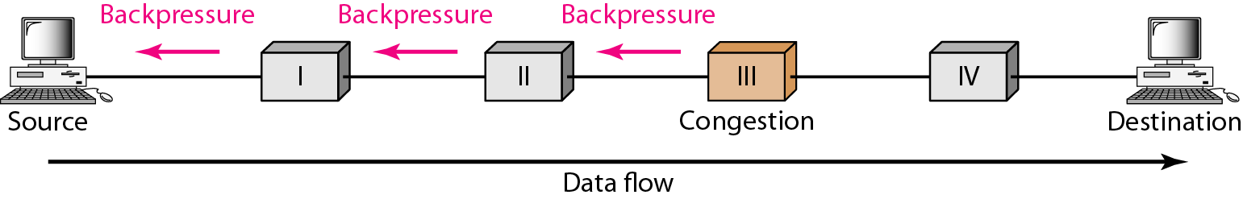
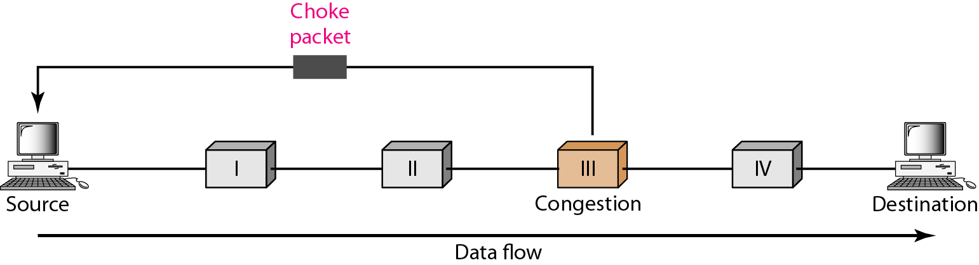
Congestion Control
Backpressure method for alleviating congestion
Choke packet

Slide 72
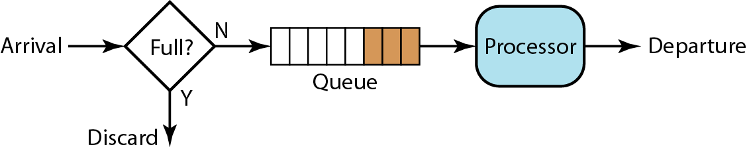
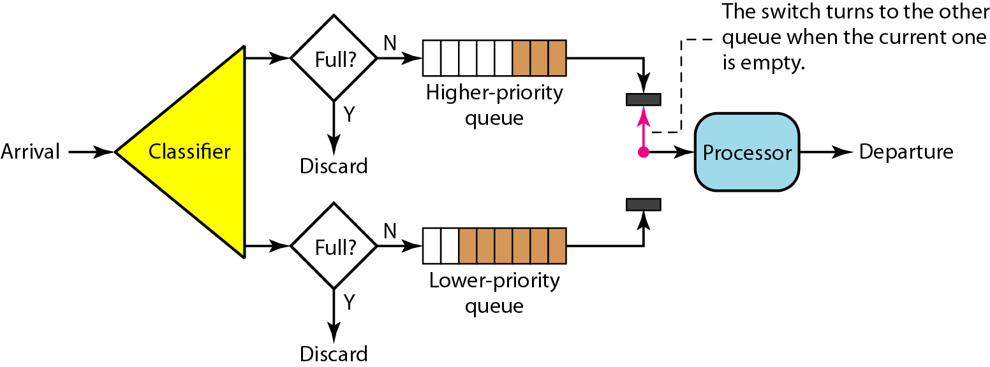
Congestion Control
FIFO queue
Priority queuing

Slide 73
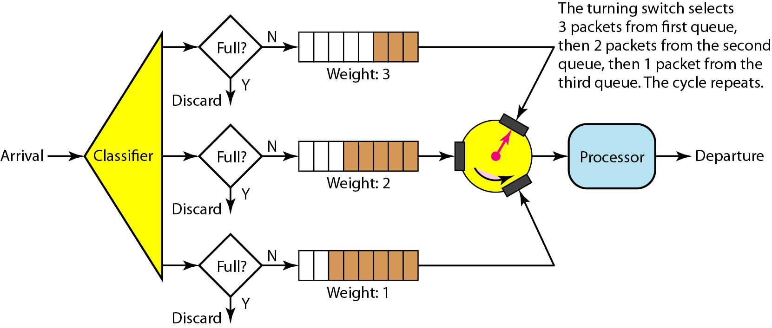
Congestion Control
Weighted fair queuing

Slide 74


Congestion Control
Leaky bucket
A leaky bucket algorithm shapes busty traffic into fixed-rate traffic by averaging the data rate. It may drop the packets if the bucket is full.
Leaky bucket implementation

Slide 75

Congestion Control
Token bucket

Slide 76
Faculty Video Links, Youtube & NPTEL Video Links and Online Courses Details
You tube/other Video Links
https://www.youtube.com/watch?v=aqtd8iZlSAA
https://www.youtube.com/watch?v=JhBnOamc_8s

Slide 77
Daily Quiz
1. Routing tables of a router keeps track of
A. MAC Address Assignments B. Port Assignments to network devices C. Distribute IP address to network devices D. Routes to use for forwarding data to its destination
2. What is the use of Ping command? A. To test a device on the network is reachable B. To test a hard disk fault C. To test a bug in an Application D. To test a Pinter Quality
3. Router and 3 layer switch work on which layer of OSI model.
A. Physical layer
B. Data Link layer
C. Network layer
D. None

Slide 78
Daily Quiz
Which is correct for IPv4 and IPv6 A. 32 & 128 B. 32 & 48 C. 48 & 128 D. 64 & 132
Find out wrong IP address A. 192.168.2.50 B.168.02.34.1 C. 127.0.0.0 D. 111.2.56.39
Class C IP address default mask address
A. 255.0.0.0 B. 255.255.255.0 C. 255.255.0.0 D. None
Hub work on which layer of OSI model
A. Physical layer B. Data Link layer C. Network layer D. None
8. Main function of network layer of OSI model
A. Routing B. Logical addressing C. Both A&B D. None
9. Which IP address version have five classes
A. IPv4 B. IPv6 C. Both A & B D. None
10. Supernetting found in which type of IP addresses
A. Classfull B. Classless C. Both A &B D. None

Slide 79
Weekly Assignment
1. A computer on 6 mbps network is regulated by a token bucket
The token bucket is filled at a rate of 1 mbps. It is initially Filled to capacity with 8 mega bits. How long can the Computer transmit at the full 6 mbps.
Solution: S=C/(M-P)=8/(6-1)=1.6 sec (CO3)
Ans
Capacity C=8 Mb
S Burst length in sec
M=6Mbps
P=1 Mbps

Slide 80
MCQ s
1. Which of the following is true of the IP address 192.0.0.10? (CO4) A) The netid is 192. B) The hostid is 0.10. C) The network address is 192.0.0.0. D) none of the above
2. A subnet mask in class A has 14 1s. How many subnets does it define?
A) 32 B) 8 C) 64 D) none of the above
3. Which IPv6 address type is used for loopback testing?
A) Unicast
B) Multicast
C) Anycast
D) Loopback

Slide 81
MCQ s
4. Given the IP address 201.14.78.65 and the subnet mask 255.255.255.224, what is the subnet address? A) 201.14.78.32 B) 201.14.78.65 C) 201.14.78.64 D) none of the above
5. Routers function in the _______ layers. A) physical and data link B) physical, data link, and network C) data link and network D) none of the above

Slide 82
Old Question Papers
http://www.ululu.in/computer-networks-solved-sample-papers-btech-6th-semester/

Slide 83
Expected Questions for University Exam
Compare routers and gateways. (CO4)
Write the IP address range of each class. (CO4)
3. Explain the need of subnet. (CO4)
4. Write acronym for ARP, RARP, ICMP(CO4)
For the given IP address 192.168.2.9 find the class, network address and host address. (CO4)
Write down default mask for each class IP address. (CO4)
Write down subnet mask for given 192.12.3.9/26 IP address. (CO4)
List the functions of network layer. (CO4)

Slide 84
Summary
In this unit 3 we have studied about Network layer of OSI model, its functions and how it handles the packet received from transport layer. Routing methods are also explained and comparison IPv4 and IPv6 completed.
To manage the traffic congestion control is covered.

Slide 85
Recap of Unit
Point-to-point networks
Logical addressing (IPv4)
Basic internetworking (IP, CIDR ARP, RARP, DHCP, ICMP)
Routing, forwarding and delivery
Static and dynamic routing
Routing algorithms and protocols
Congestion control algorithms
IPv6.

Slide 86
References
Books:
Forouzen, "Data Communication and Networking",TMH
A.S. Tanenbaum, Computer Networks, Pearson Education
W. Stallings, Data and Computer Communication, MacmillanPress
Thank You

